Slide 1

Missing Child Identification Using LBPH and Open CV
by
K. Vyshnavi
Roll No. 204G1A05C4
M. Srikanth reddy
Roll No. 204G1A05A2
Y. Rajya lakshmi
Roll No. 204G1A0577
P. Lakshmi prasanna
Roll No. 194G5A0514
Under the guidance of
Dr. T.Venkata Naga Jayudu M.Tech., Ph.D
Associate Professor
Department of Computer Science and Engineering
Srinivasa Ramanujan Institute of Technology
(Autonomus)
2023 - 2024

Slide 2

Contents
Review-0 Comments
Abstract
Problem statement
Objectives of Project
Literature survey for first objective
Objective-1(Design & Implementation)
Literature survey for second objective
Proposed Work -(Methods to be followed for proposed system)
References
GitHub Link
Queries

Slide 3
Abstract
India struggles with numerous missing children every year, and many childrens remain untraced. To address this issue the proposed system would help the police and the public by accelerating the process of searching using face recognition. When a child goes missing, the parent login into portal and can upload the latest picture and details of the child. When the case is registered and he/she get stores in the database.
With the advent of the technology, especially cameras which are installed in many public and private areas to provide surveillance activities. The footage of the cameras be used to recognize the pre-trained missing child with the help of Local Binary Patterns Histogram (LBPH) face recognition. In this, the model build a web based automated facial recognition system integrated with backend machine learning for Missing Child database using known Haar feature-based cascade classifier. If matching is found, then it will send an email to the authorities.
Keywords: Missing Child, LBPH, Haar cascade classifier and Open CV.

Slide 4
Problem Statement
In India now-a-days, there are more incidences of children going missing. It will take a long time to locate the youngster for the police academy using the conventional manual searching methods, which include maintaining and analyzing records of missing children and conducting physical searches for them throughout the city.
To aid the police academy in a speedy search process and to save the lives of youngsters. This model will enable us to increase the speed, precision, and inclusiveness of missing child identification.

Slide 5
Review-0 Comments
Define scope of your project?
In this project, only one frame will be detected at a time, which will detect multiple human faces. This process will start after the case is registered.
What is feature extraction?
Feature extraction is a process in data analysis and machine learning where raw data is transformed into a reduced and more informative representation, known as features. These features are designed to capture the most relevant information in the data, making it easier to analyze, interpret, and use for various tasks such as classification, clustering and pattern recognition.
What is human behavioral analysis?
Human behavioral analysis is the study of human actions, interactions, and reactions in various contexts.

Slide 6
Review-0 Comments
Some of the Behavioral studies are:
Psychology and Psychometrics
Cognitive Behavioral Analysis
Social and Cultural Analysis
Behavioral Economics

Slide 7
Objectives of Project
Research Objective1:To develop automated facial recognition system using Local Binary Patterns Histogram (LBPH) and Haar feature-based cascade classifier to detect and match missing children's faces, by utilizing the latest parent-provided images for efficient identification.
Research Objective2:To improve speed and accuracy of the missing children location process Implementing an user interface with email mechanism that will inform the authorities as soon as they are detected, enable rapid response and reunification of missing children with their families.

Slide 8
Literature survey for first objective
This paper, outline a survey on various techniques used for face recognition, which is one of the most widely used applications of image analysis and understanding. Face recognition system involves three main steps: face detection, feature extraction, and face recognition and also discusses the challenges and issues related to face recognition, such as illumination and pose variations, and provides a brief overview of some representative methods.[1]
In this paper, the author used Haar-Cascade method, Open CV libraries To detect the face in the image or video. The Open CV library is used in various applications that pertain to the field of robotics, biometrics, image processing, and other areas where visualization is important and includes an implementation of Haar classifier detection and training in each step.[2]

Slide 9
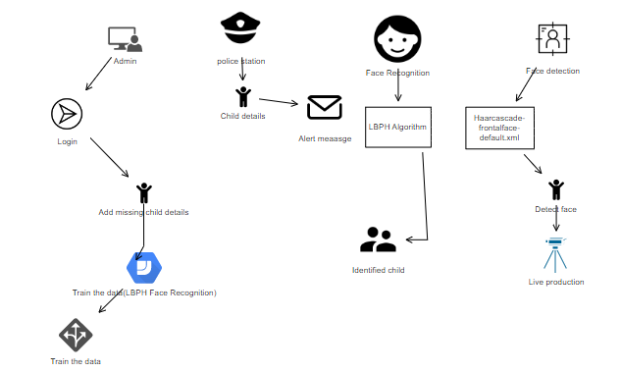
Design and Implementation of first objective
Fig 1.1 Architecture

Slide 10
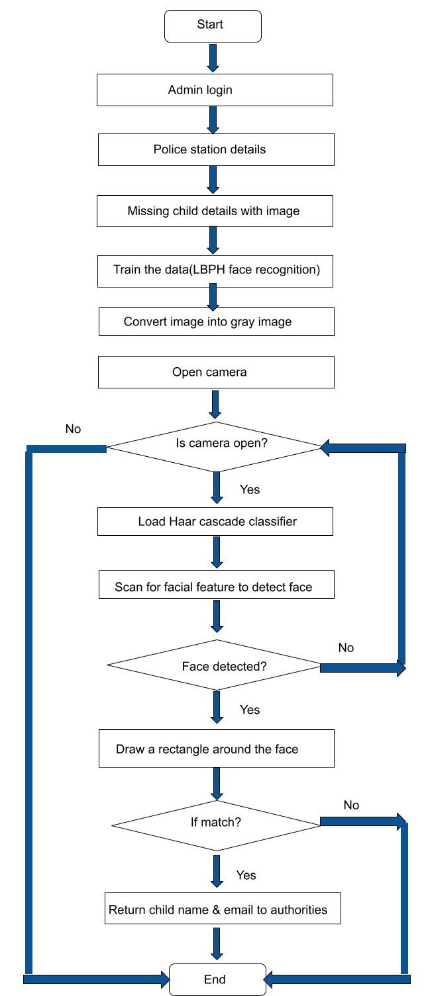
Design and Implementation of first objective
Fig 1.2 Flow Chart

Slide 11
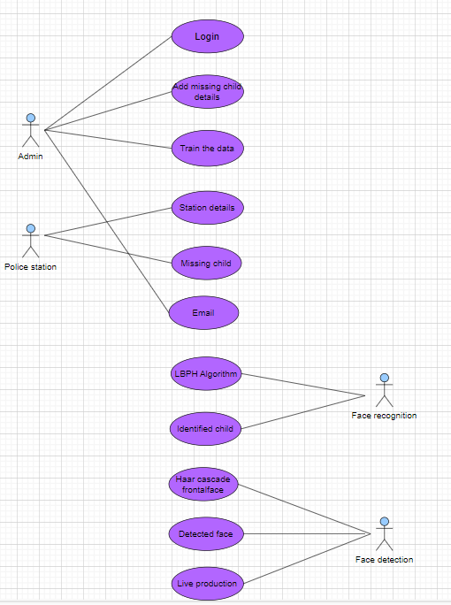
Design and Implementation of first objective
Fig 1.3 Use Case Diagram

Slide 12
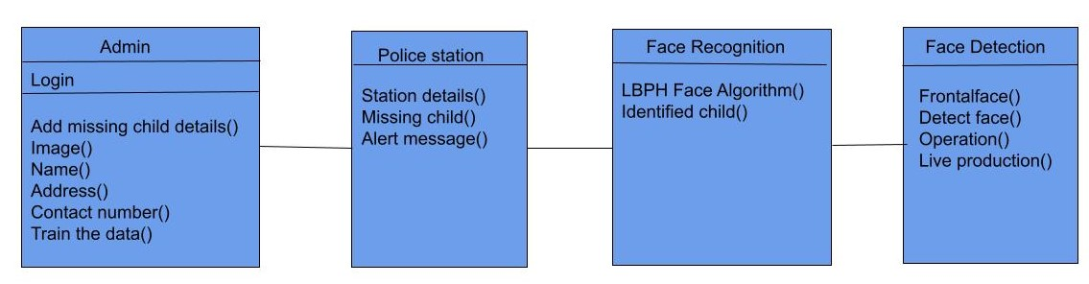
Design and Implementation of first objective
Fig 1.4 Class Diagram

Slide 13
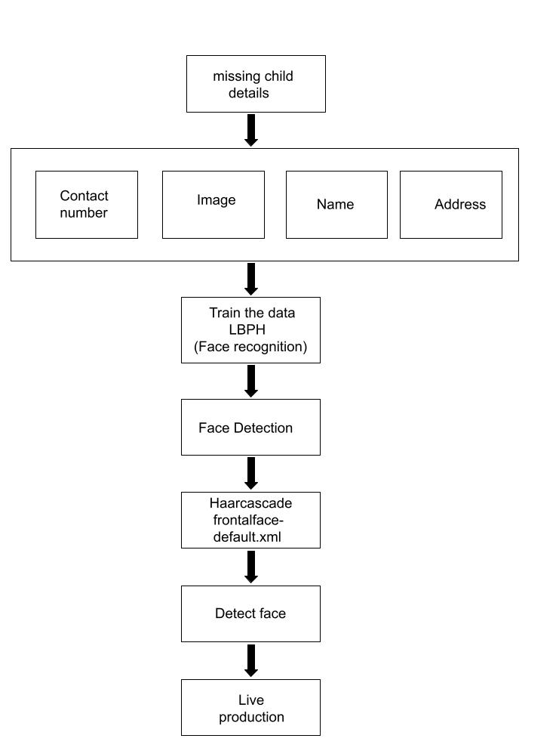
Design and Implementation of first objective
Fig 1.5 Block Diagram for first Objective

Slide 14
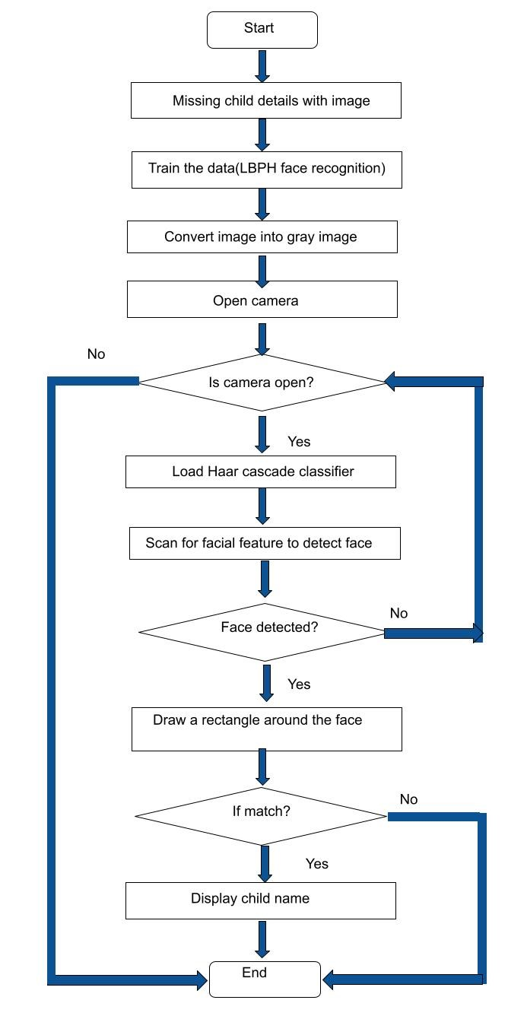
Design and Implementation of first objective
Fig 1.6 Flow Chart for first Objective

Slide 15
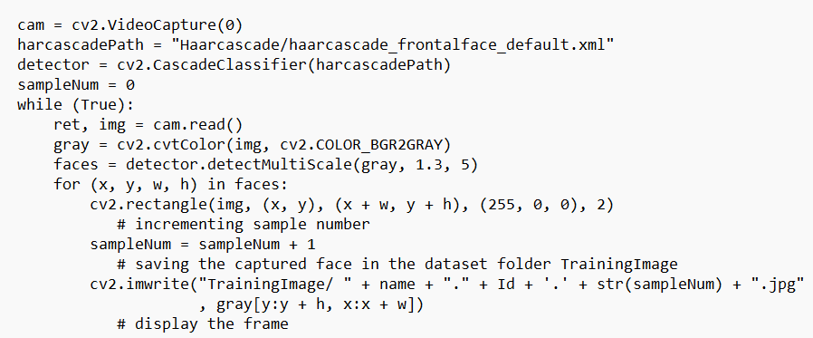
Design and Implementation of first objective
Implementation
Face Detection : Haar cascade classifier

Slide 16
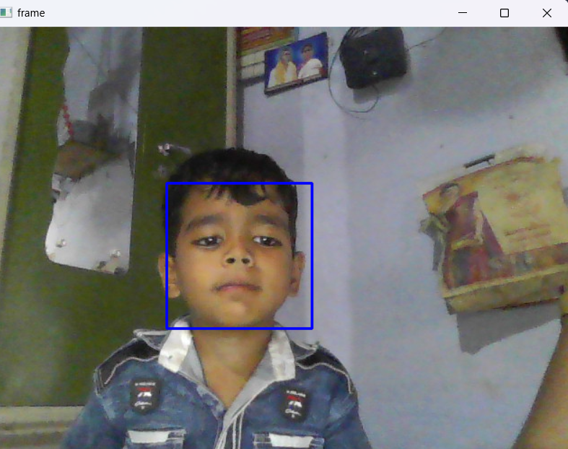
Design and Implementation of first objective
Child Face Detection:

Slide 17
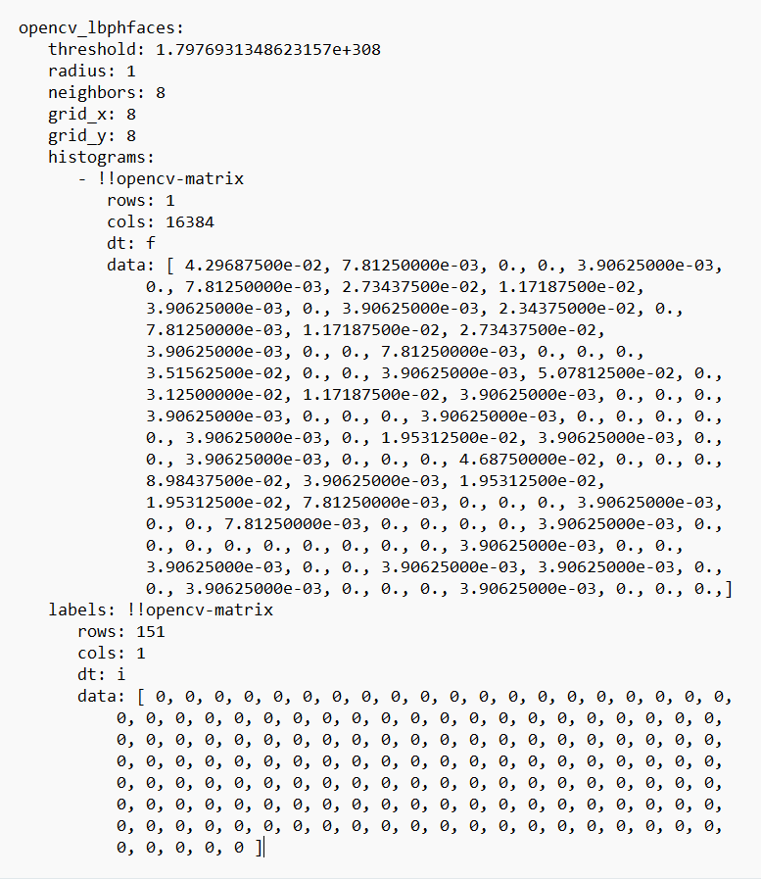
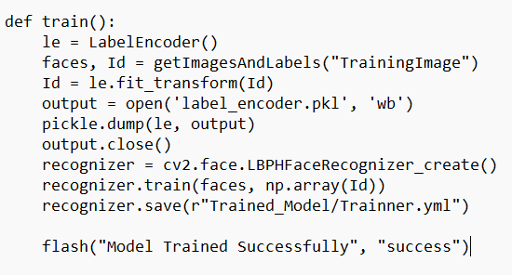
Design and Implementation of first objective
Implementation
Face Recognizer: LBPH Algorithm

Slide 18
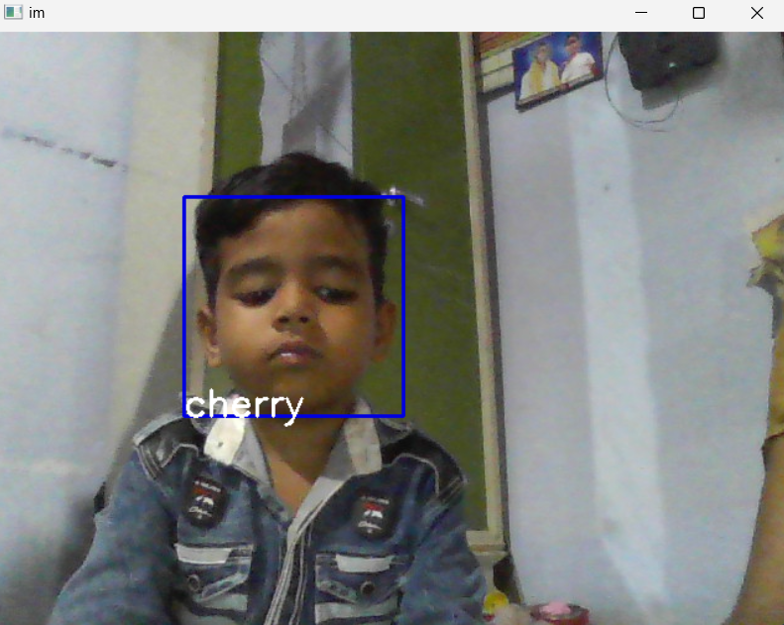
Design and Implementation of first objective
Missing Child Face Recognition:

Slide 19
Literature survey for second objective
In this paper, the author used the Local Binary Patterns Histogram (LBPH) algorithm architecture to address the human face recognition in real time at the low level of resolution. Over the years, many scholars have developed a variety of face recognition algorithms, but Those all algorithms provide an accuracy rate between 50%-76%. The LBPH algorithm not only recognizes the front face but also the side face, with a 90% accuracy rate.[3]

Slide 20
Proposed System
To overcome the difficulties of the existing system i.e., incorrect results and time consuming processes, the proposed system built a web based missing child identification system integrated with machine learning and that could be implemented by our police department to acknowledge the Missing Childs from the input faces. It will allow the parents to login and upload details of missing child.
The system uses Haar-Cascade Face classifier in Open CV approach and Local Binary Patterns Histogram (LBPH) face recognition algorithm to accurate child identification.

Slide 21
References
[1]. Sandeep Mishra, Anupam Dubey “Face Recognition Approaches: A Survey”, International Journal of Computing and Business Research (IJCBR), vol.6, pp. 1, January. 2015.
[2]. K.H Wanjale, Amit Bhoomkar, Ajay Kulkarni, Somnath Gosavi “Use Of Haar Cascade Classifier For Face Tracking System In Real Time Video”, International Journal of Engineering Research & Technology (IJERT), vol. 2, pp. 4, April. 2013.
[3]. Aftab Ahmed, Jiandong Guo, Fayaz Ali Dharejo, Farha Deeba, Awais Ahmed “LBPH Based Improved Face Recognition At Low Resolution”, International Conference on Arificial Intelligence and Big Data (ICAIBD), May. 2018.

Slide 22

Git Hub Dashboards of each student
Github Link: https://github.com/204G1A05c4/CSE-2020-2024-B1.git

Slide 23
Any Queries?

